Slide 1
CSP 554 Big Data Technologies
Module 04
Hive

Slide 2
Hadoop For Big Data Management
The Hadoop ecosystem has emerged as a cost-effective way of working with large data sets
It imposes a particular programming model, called MapReduce
Underneath this computation model is the Hadoop Distributed Filesystem (HDFS)
However, a challenge remains…
How do you move an existing data infrastructure to Hadoop
When that infrastructure is based on traditional relational databases and the Structured Query Language (SQL)?
What about the large base of SQL users, both expert database designers and administrators
As well as casual users who use SQL to extract information from their data warehouses?
This is where Hive comes in

Slide 3
Apache Hive
An open source SQL-like system built on top of Hadoop for querying and analyzing large datasets
As an alternative to writing complex MapReduce jobs, with Hive, you just need to submit SQL-like queries
Hive is targeted towards users who are comfortable with SQL and abstracts the complexity of Hadoop
Hive use a language called HiveQL (HQL), which is very similar (although not completely identical) to SQL
The Hive system operates by automatically translating SQL-like queries into (optimized) MapReduce jobs
Or jobs for one of two more specialized parallel execution engines: Tez or LLAP

Slide 4
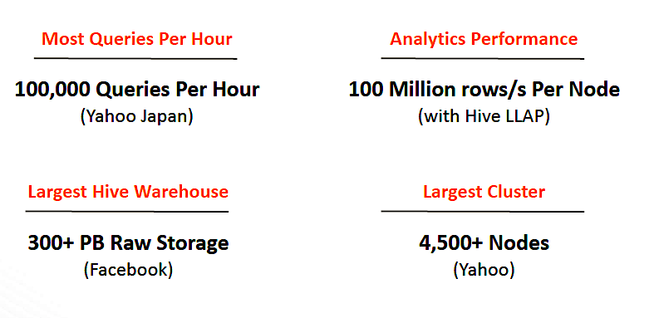
Hive Usage

Slide 5
Some Hive Alternatives
Apache Impala
Developed by Cloudera
Apache Drill
Presto
Facebook
SparkSQL
We will explore this as well
AWS Athena
Performs SQL queries over the contents of S3 buckets

Slide 6
Who Developed Hive and Why
Facebook confronted significant challenges working with big data before their implementation of Apache Hive
The volume of the data Facebook generated exploded, making it very difficult to handle
And their traditional relational database systems could not handle the load
As a result, Facebook began looking or better options
Facebook initially tried using MapReduce but they found it difficult to program
On the other hand their development organization had a deep knowledge of SQL
Hive allowed them to overcome the challenges they were facing: (1) big data and (2) limited MapReduce knowledge

Slide 7
Who Developed Hive and Why
SQL knowledge is widespread for a reason
It’s an effective, reasonably intuitive model tor organizing and using data
Mapping these familiar data operations to the low-level MapReduce Java API can be daunting
Even for experienced Java developers
Hive does this dirty work for you, so you can focus on the query itself
Hive translates most queries to MapReduce jobs exploiting the scalability of Hadoop
While presenting a familiar SQL abstraction.

Slide 8
Who Developed Hive and Why
Most data warehouse applications are implemented using relational databases that use SQL as the query language
Hive lowers the barrier for moving these applications to Hadoop
People who know SQL can learn Hive easily
Without Hive, these users must learn new languages and tools to become productive again
Hive makes it easier for developers to port SQL-based applications to Hadoop, compared to other tool options
Without Hive, developers would face a challenge when porting their SQL applications to Hadoop

Slide 9
But Hive is Not…
Not a relational database, but a parallel processing layer over HDFS and S3
Hive complies HQL requests into a job executed by one of the MapReduce, Tez (specific to Hive) or Spark execution engines
Not designed for On Line Transaction Processing (OLTP), but is used for data exploration, analysis, and reporting
Not a system for supporting real-time queries
Because Hadoop is a batch-oriented system, Hive queries have higher latency due to the start-up overhead for MapReduce jobs
Queries that would finish in seconds for a relational database take longer for Hive, even for relatively small data sets
Because the data files or S3 objects it processes are not specially formatted for efficient SQL queries
Not a system supporting updates to records/rows or ACID semantics in general but only under special conditions

Slide 10
Hive For Big Data Management
So, Hive doesn’t provide crucial features required for OLTP, Online Transaction Processing
It’s closer to being an OLAP tool, Online Analytic Processing,
But Hive isn’t ideal for satisfying the “online” part of OLAP, at least today
Since there can be significant latency between issuing a query and receiving a reply,
Due to the overhead of Hadoop and due to the size of the data sets Hadoop was designed to serve.
If you need OLTP features for large-scale data, you should consider using a NoSQL database:
Hbase—a NoSQL database integrated with Hadoop,
Commercial (also Cloud) NoSQL Databases: Cassandra, MongoDB
Cloud NoSQL Databases: AWS DynamoDB, Azure CosmoDB

Slide 11
How Hive Works
Hive has a compiler taking one language—HQL—and converting it in to code for a parallel processing engine
And that code executes against data stored in HDFS or S3
But the question arises: how did the data get into HDFS files or S3 objects in the first place?
And the answer is: by any of a number of means… Via Sqoop, MapReduce, Spark, etc.
But that means any process can create and organize data in HDFS and S3 outside of the awareness of Hive
And because of this Hive has no control over what format the data in HDFS or S3 might be

Slide 12
How Hive Works
Now this is very different from relational databases
A relational database controls the format of the data it manages on behalf of its clients
Hive must adapt its processing to make use of the format of data controlled by other clients
The database system already knows the format of the data to be queried
Client must inform Hive as to the format of the data to be queried as it is out of Hive’s control
Relational Database Client
Hive Client
SQL Query Compiler
HQL Query Compiler
MapReduce
Tez (Custom for Hive)
LLAP (Custom for Hive)
Database
Management
System
Query Processing Engine
Parallel Processing Engine
DB Storage Manager
No Hive Storage Manager
The query processing engine & DB storage manager have built in knowledge of the default storage format
OS-based File System
HDFS or S3 Systems
HDFS or S3 Client
Data
Data

Slide 13
How Hive Works
Relational Database
The table definition assumes the database storage engine has control of the format of stored data and the query processing engine also knows that format…
So, there s no need to describe the table data format as part of the schema definition
CREATE TABLE employees (
name VARCHAR,
state VARCHAR);
Hive
The Hive query processing engine does not control or have knowledge of the format of data in HDFS or S3
So, the table definition includes a detailed spec of the format of of the stored data…
CREATE TABLE employees (
name STRING,
state STRING)
ROW FORMAT DELIMITED
FIELDS TERMINATED BY ‘\001'
COLLECTION ITEMS TERMINATED BY ‘\002'
MAP KEYS TERMINATED BY ‘\003'
LINES TERMINATED BY ‘\n'
STORED AS TEXTFILE
LOCATION ‘hdfs://user/Hadoop/mydata.txt’;
A table schema can be superimposed over an existing HDFS file or S3 object

Slide 14
Hive Example
Create a Hive database. This does not allocate any storage only create a name space
CREATE DATABASE IF NOT EXISTS DemoDB;

Slide 15
Hive Example
Define the schema of a table in the DemoDB database
Indicate each record (row) in the database has tab separated fields and each record (row) is terminated with a newline (‘\n’)
CREATE TABLE IF NOT EXISTS DemoDB.salaries (
name STRING,
jobTitle STRING,
agencyID STRING,
agency STRING,
hireDate STRING,
annualSalary DOUBLE,
grossPay DOUBLE)
ROW FORMAT DELIMITED
FIELDS TERMINATED BY ‘\t'
LINES TERMINATED BY ‘\n'
STORED AS TEXTFILE;
The default is CTRL-A (/001). Here fields are separated by tabs
This is the default, no need to mention in practice
This is the default, no need to mention in practice

Slide 16
Hive Example
Load data from a Linux file holding records with tab separated fields
This data is held in an HDFS file managed by Hive
LOAD DATA LOCAL INPATH './Salaries.tsv’
OVERWRITE INTO TABLE DemoDB.salaries;
Now you can query information from this table (actually an HDFS file)
SELECT name FROM DemoDB.salaries
WHERE agency = ‘Finance’;

Slide 17
Hive
An essential tool in the Hadoop ecosystem…
That provides an SQL (Structured Query Language) dialect…
Hive provides an SQL dialect called Hive Query Language (HiveQL, HQL)…
For querying data stored in the Hadoop Distributed Filesystem (HDFS)…
Or other filesystems that integrate with Hadoop
Such as Amazon’s S3…
And databases like HBase (the Hadoop database)

Slide 18
Hive Query Language (HIVEQL, HQL) Capabilities
Hive's SQL provides the basic SQL operations
These operations work on tables or partitions
Operations are:
Ability to filter rows from a table using a WHERE clause
Ability to select certain columns from the table using a SELECT clause
Ability to do equijoins between two tables
Ability to evaluate aggregations on multiple "group by" columns for the data stored in a table
Ability to store the results of a query into another table
Ability to download the contents of a table to a local directory
Ability to manage tables and partitions (create, drop and alter)

Slide 19
Hive New Features Transactional Read and Write
Originally Hive supported write only by adding partitions or loading new files into existing partitions
Support record level INSERT, UPDATE, DELETE
Example transactional table definition
CREATE TABLE T(a int, b int) STORED AS ORC TBLPROPERTIES ('transactional'='true');
Restrictions
Managed Table
Table cannot be sorted
Currently requires ORC file format
… and others

Slide 20
Hive New Features Other
HPLSQL
Procedural SQL (stored procedures), similar to Oracle’s PL/SQL and Teradata’s stored procedures
Adds cursors, loops (FOR, WHILE, LOOP), branches (IF), HPLSQL procedures, exceptions (SIGNAL)
Aims to be compatible with major dialects of procedural SQL to maximize re-use of existing scripts
LLAP
Persistent daemons
Saves time on process start up (eliminates container allocation and JVM start up time)
All code JITed within a query or two
Hot data cached in memory (columnar aware, so only hot columns cached)
When possible work scheduled on node with data cached, if not work will be run in other node
HBase Metastore
Add option to use HBase to store Hive’s metadata
Hive-On-Spark Improvements
Cost Based Optimizer Improvements

Slide 21
WordCount MapReduce Java API (Partial)
public static class Map extends Mapper<LongWritable, Text, Text, IntWritable> {
private final static IntWritable one = new IntWritable(1);
private Text word = new Text();
public void map(LongWritable key, Text value, Context context)
throws IOException, InterruptedException {
String line = value.toString();
StringTokenizer tokenizer = new StringTokenizer(line);
while (tokenizer.hasMoreTokens()) {
word.set(tokenizer.nextToken());
context.write(word, one);
}
}
}
public static class Reduce extends Reducer<Text, IntWritable, Text, IntWritable> {
public void reduce(Text key, Iterable<IntWritable> values, Context context)
throws IOException, InterruptedException {
int sum = 0;
for (IntWritable val : values) {
sum += val.get();
}
context.write(key, new IntWritable(sum));
}
}

Slide 22
WordCount HiveQL (Full)
CREATE TABLE docs (line STRING);
LOAD DATA INPATH 'docs' OVERWRITE INTO TABLE docs;
CREATE TABLE word_counts AS
SELECT word, count(1) AS count FROM
(SELECT explode(split(line, '\s')) AS word FROM docs) w
GROUP BY word
ORDER BY word;

Slide 23
WordCount
In both examples, files were tokenized into words using the simplest possible approach; splitting on whitespace boundaries
This approach doesn’t properly handle punctuation
It doesn’t recognize that singular and plural forms of words are the same word, etc. However, it’s good enough for our purposes here
The virtue of the Java API is ability to customize each detail of algorithm implementation
However, most of the time, you just don’t need that level of control and it slows you down considerably when you have to manage all those details.
If you’re not a programmer, then writing Java MapReduce code is largely out of reach
However, if you already know SQL, learning Hive is relatively straightforward and many applications are quick and easy to implement

Slide 24
Hive For Big Data Management
So, Hive is best suited for data warehouse applications, where a large data set is maintained and mined for insights and to produce reports
Because data warehouse applications are implemented using SQL-based relational databases…
Hive lowers the barrier for moving these applications to Hadoop.
But, unlike most SQL dialects…
HiveQL does not conform to the ANSI SQL standard
And it differs in various ways from the familiar SQL dialects provided by Oracle, MySQL, and SQL Server
However, it is closest to MySQL’s dialect of SQL

Slide 25
Hive For Big Data Management

Slide 26
Relational Databases Versus Hive
Let’s say I have a file of records and I want to write them into a relational database to query them using SQL
Imagine the file is in HDFS as /user/Hadoop/mydata.txt
Can I do the following
Create a database called ‘Demo’ in my RDBMS (relational database management system)
Insert each record from mydata.txt into database ‘Demo’
Define a table/schema for the data I just wrote to the database
Query the data
No!!!
You can only write data into a database after you define a table schema
This is referred to as “Schema on Write”
You must have a table schema defined before you write any data to a database

Slide 27
Relational Databases Versus Hive
Now say I have a file of records and I want to write them into a Hive database to query them using HQL
Imagine the file is in HDFS as /user/Hadoop/mydata2.txt
Can I do the following
Create a database called ‘Demo’ in Hive
Use the file mydata2.txt exactly as it is without having to somehow specially write it into Hive, because Hive just uses HDFS files directly
So any file written to HDFS can become a Hive database table
When I want to query the data, only then define a table/schema to superimpose over the existing file mydata2.txt
Query the data
Yes!!
You can use any HDFS file as a table in a Hive database
This is referred to as “Schema on Read”
Your schema can be defined after the data file which it describes already exists
You need a table schema, not when you write the data (data is just an HDFS file which you can have written previously)…
But when you want to query/read the data

Slide 28
Relational Databases Versus Hive
Hive enforces schema on read whereas RDBMS enforces schema on write
In RDBMS, a table’s schema is enforced at data load time
If the data being loaded doesn’t conform to the schema, then it is rejected
But Hive doesn’t verify the data when it is loaded, but rather when a it is queried
Schema on read makes for a very fast initial load, since the data does not have to be read, parsed, and serialized to disk in the database’s internal format.
The load operation is just a copy or move to HDFS directory
Schema on write makes query time performance faster, since database can index columns and perform compression on the data
But it takes longer to load data into the database.
Hive is based on the notion of Write once, Read many times but RDBMS is designed for Read and Write many times
In RDBMS, record level updates, insertions and deletes, transactions are possible
These are not allowed in Hive because Hive was built to operate over HDFS data using MapReduce, where full-table scans are the norm
And a table update is achieved by transforming the data into a new table.

Slide 29
Relational Databases Versus Hive
In RDBMS, the maximum data size allowed will be in 10’s of Terabytes where Hive can handle 100’s Petabytes easily
As Hadoop is a batch-oriented system, Hive doesn’t support OLTP (Online Transaction Processing) but is closer to OLAP (Online Analytical Processing)
But there is significant latency between issuing a query and receiving a reply
Due to the overhead of MapReduce jobs
Due to the size of the Hadoop data sets
RDBMS is best suited for dynamic data analysis where fast responses are expected
But Hive is suited to data warehouse applications, where relatively static data is analyzed
Fast response times are not required
The data is not changing that rapidly
To overcome the limitations of Hive, HBase is being integrated with Hive to support record level operations and OLAP

Slide 30
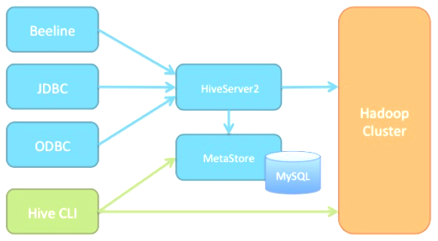
Hive Architecture

Slide 31
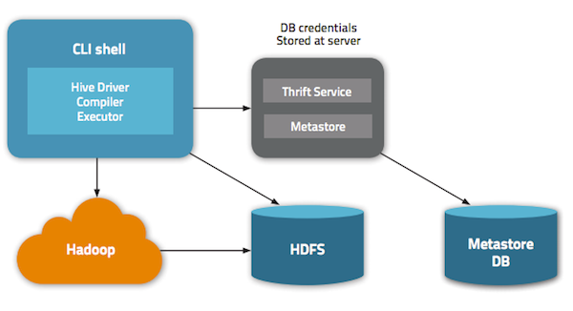
Hive Architecture

Slide 32
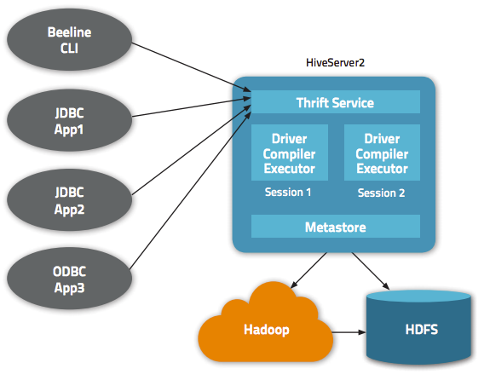
Hive Architecture

Slide 33
Hive Architecture
Hive requires only one extra component that Hadoop does not already have; the metastore component
The metastore stores metadata such as table schema and partition information
Any JDBC-compliant database can be used for the metastore
In practice, most installations of Hive use MySQL or similar open source database
Hive metastore HA requires a database that is highly available…
Such as MySQL with replication in active-active mode

Slide 34
Hive Architecture
The information required for table schema, partition information, etc., is small
Typically much smaller than the large quantity of data stored in Hive
As a result, you typically don’t need a powerful dedicated database server for the metastore
However because it represents a Single Point of Failure (SPOF), it is strongly recommended that…
You replicate and back up this database using standard techniques you would normally use with other relational database instances

Slide 35
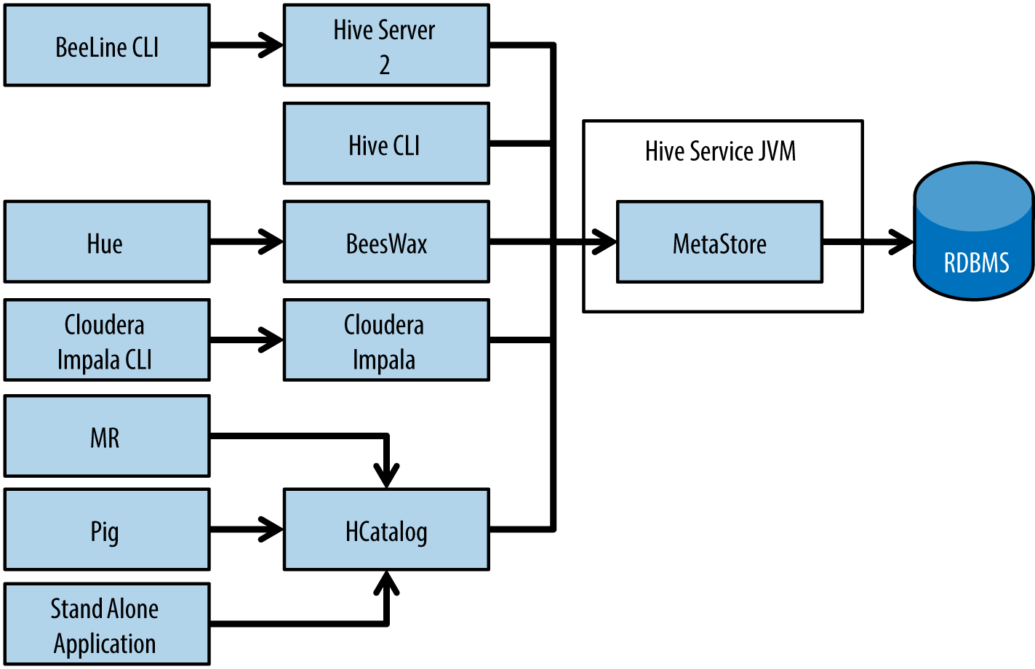
Hive Architecture
HCatalog is a table and storage management layer for Hadoop that enables users with different data processing tools — Pig, MapReduce — to more easily read and write data using HDFS

Slide 36
Hive Architecture
HCatalog is built on top of the Hive metastore and incorporates Hive's DDL
HCatalog provides read and write interfaces for Pig and MapReduce
Uses Hive's command line interface for issuing data definition and metadata exploration commands
HCatalog’s table abstraction presents users with a relational view of data in HDFS
Ensures users need not worry about where or in what format their data is stored
RCFile format, Text file format, SequenceFiles, or ORC files

Slide 37
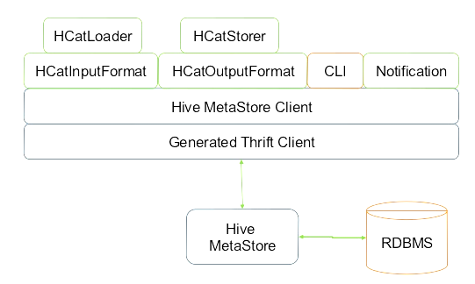
Hive Architecture
Pig

Slide 38
Hive Architecture
Parse HQL Command(s)
Plan MapReduce Pipeline
Optimize MapReduce Pipeline
Execute MapReduce Jobs

Slide 39
HiveQL Code to Retrieve Data from 3 Tables
SELECT a.occ_code, c.occ_name, COUNT(*) AS cnt, AVG(b.value) AS avg
FROM occup a
JOIN occupdata b ON (a.sid = b.sid)
JOIN jobs c ON (a.occ_code = c.occ_code)
GROUP BY a.occ_code, c.occ_name
ORDER BY avg DESC

Slide 40
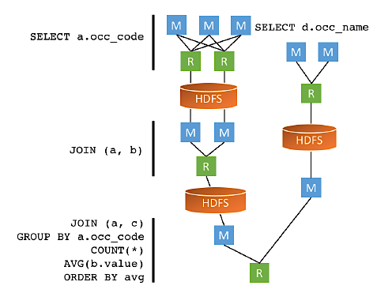
Computation Model of MapReduce.
The following increases the cost and time of the MapReduce execution:
To execute this query using the MapReduce execution engine, Hive must launch 4 MR jobs
Each MR job has its own start-up time and after processing writes result to HDFS providing data to a subsequent job for read.

Slide 41
Computation Model of Tez
In contrary to MapReduce, Tez performs complex queries as a single execution graph
Tez doesn’t implement wasteful intermediate IO operations with HDFS
Vertexes in the execution graph are processing jobs and edges are data streams
Tez supports “hot containers” to start jobs immediately without wasting time for
start-up

Slide 42
Live Long and Process (LLAP)
LLAP is the newest computation paradigm implemented for Hive
It consists of the set of persistent daemons (processes) that execute fragments of Hive queries
This persistency allows to start jobs much faster, since containers do not need warm-up.

Slide 43
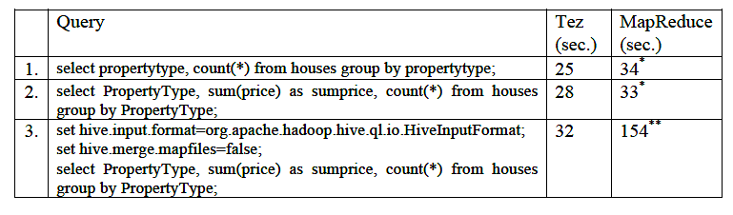
Example Query Performance by Execution Engine

Slide 44
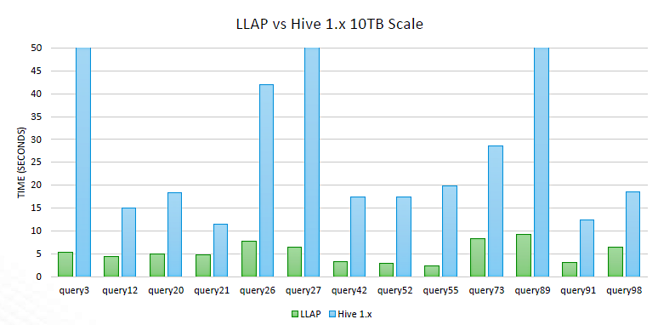
Example Query Performance by Execution Engine

Slide 45
How Do I Execute Hive Commands Interactively?
The command line interface or CLI is one of the most common ways to interact with Hive
Using the CLI you can create databases, create tables, query tables and so on

Slide 46
How Do I Execute Hive Commands Interactively? Hive CLI (old)
Hive CLI is a thick client holding logic needed to compile hive commands into MapReduce jobs and execute them on a cluster
Hive CLI connects directly to HDFS and Hive Metastore
Can only be used on a client server with direct access to Hadoop cluster services
Hive CLI depends on HDFS storage access permission for security

Slide 47
How Do I Execute Hive Command Interactively? Beeline (new)
Due to security limitations and need for all hive software to be available on the client server the Hive CLI is being deprecated in favor of the Beeline CLI
The Beeline CLI connects to the Hadoop HiveServer2 service via standard JDBC connections and does not require installation of most Hive libraries on the client machine
Only one .jar file: hive-jdbc-<version>-standalone.jar.
We can run Beeline with limited access to Hadoop cluster and use SQL/JDBC standard-based authorization

Slide 48
Starting Beehive
Enter the following all on one line:
beeline -u jdbc:hive2://localhost:10000/ -n hadoop -d org.apache.hive.jdbc.HiveDriver --showDbInPrompt=true
-u <database URL>
The database URL to connect to
-n <username>
The user name to connect as
-d <driver class>
The driver class to use
Our choice makes Beeline behave more like the Hive CLI
--showDbInPrompt=[true/false]
Display the current database name in prompt. Default is false

Slide 49
How Do I Execute Hive Commands From a File?
If you are already in Beeline you can use the “source” command to execute a script file (
0: jdbc:hive2://localhost:10000/ (default)> source /path/to/file/mycmds.hql
Or equivalently you can use the “!run” command to execute a script file (standard Beeline command)
0: jdbc:hive2://localhost:10000/ (default)> !run /path/to/file/mycmds.hql

Slide 50
How Do I Add Comments to My Hive Command Files?
You can embed lines of comments that start with “--” (two hyphens)
file: mycmds.hql
-- data and time
-- Intent of the script
SELECT * FROM someTable;
Beeline does not parse these comment lines, if you paste then into the CLI you will get errors

Slide 51
How Can I Execute a Single Hive Command From the Shell Command Line?
One can use this feature to find a Hive property name easily
beeline … –e “set;” | grep warehouse
hive.metastore.warehouse.dir=/user/hive/warehouse
hive.warehouse.subdir.inherit.perms=true

Slide 52
How Can I Exit Beeline Interactive Mode?
Simply type “!quit;” followed by the command and terminate the line with a “;”
0: jdbc:hive2://localhost:10000/ (default)> !quit

Slide 53
How Can I Execute Hadoop File System Commands From Hive CLI Interactive Mode?
You can run the “hadoop fs” commands from within the beeline CLI
Just enter “dfs” followed by the command then an “;” at the end
0: jdbc:hive2://localhost:10000/ (default)> dfs –ls / ;

Slide 54
How Can We View and Modify Hive Configuration Parameters?
The Beeline maintains its configuration parameters in a set of variables internally stored as Java Strings
You can the values of preexisting variables or add user defined ones
You can reference variables in queries where Hive replaces the reference with the variable’s value
Inside the Beeline variables are displayed and changed using the SET command
To output the names and values of all variables
0: jdbc:hive2://localhost:10000/ (default)> set;

Slide 55
How Can We View and Modify Hive Configuration Parameters?
To output the name and values a single variable
0: jdbc:hive2://localhost:10000/ (default)> set hive.cli.print.current.db
hive.cli.print.current.db =true
To change the value of a variable
0: jdbc:hive2://localhost:10000/ (default)> set hive.cli.print.current.db = false;
We will only focus on a few useful or needed variables in our course

Slide 56
What is a Hive “Database”?
Hive is a technology that can define databases and tables to analyze structured or semi-structured data
The theme for such data analysis is to store the data in a tabular manner, and issue queries to analyze it
Although the words are the same, the terms database and table do not mean quite the same thing for Hive as for any relational database management system (RDBMS)
An RDBMS database is a construct holding the content of tables along with metadata describing access permissions and storage characteristics and other properties

Slide 57
Data Units
Database
Table
Partition
Bucket
Namespaces function to avoid naming conflicts for tables, partitions, columns, and so on. Databases can also be used to enforce security for a user or group of users.
Records of data described by the same schema
Each Table can have organized into one or more partitions based on the values of a column which determines how the data is grouped
Data in each partition may in turn be divided into buckets based on some column of the Table

Slide 58
DML Commands
CREATE
CREATE DATABASE …
CREATE TABLE …
DROP
DROP DATABASE …
DROP TABLE …
SHOW
SHOW DATABASES
SHOW TABLES
DESCRIBE
DESCRIBE DATABASE …
DESCRIBE TABLE …
USE
USE …

Slide 59
What is a Hive Database?
Hive uses MapReduce (or Tez) for processing…
HDFS (or S3) for storage…
And a small RDBMS and service process for metadata
For Hive a database is not a storage construct but has two purposes
A namespace to disambiguate (avoid naming conflicts for) tables of the same name that may be associated with different projects
Db1.Customers and Db2.Customers are two separate tables under Hive even though each has the same name
So it is common to use databases to organize production tables into logical grouping
Databases can also be used to enforce security (access) policies for users and groups
In Hive if a table is not explicitly associated with some named database it is associated with “default”

Slide 60
DML Commands CREATE DATABASE …
Description
Used to create a database in Hive. A database in Hive is a namespace or a collection of tables
Syntax
CREATE DATABASE [IF NOT EXISTS] database_name
[COMMENT database_comment]
[LOCATION hdfs_s3_path]
[MANAGEDLOCATION hdfs_s3_path]
[WITH DBPROPERTIES (property_name=property_value, ...)];

Slide 61
DML Commands CREATE DATABASE …
The simplest syntax for creating a database is as follows
CREATE DATABASE someDatabase;
Hive will indicate an error if “someDatabase” already exists
You can suppress this error indication with the following variation
CREATE DATABASE IF NOT EXISTS someDatabase;
The above is useful for scripts that create a database only if it does not exist and otherwise use the existing one

Slide 62
DML Commands CREATE DATABASE …
Example
Create a databases called demo (if it does not exist) as a subdirectory of the HDFS ‘user/hive/warehouse’ directory path:
CREATE DATABASE IF NOT EXISTS demo
COMMENT “This is a demo database”;
Create a databases called demo2 (if it does not exist) in the already existing S3 bucket ‘mydbs’:
CREATE DATABASE IF NOT EXISTS demo2
COMMENT “This is another database”
LOCATION ‘s3://mydbs/demo2.db’;

Slide 63
DML Commands CREATE DATABASE …
Hive will create an HDFS directory or S3 for each database
Tables in that database will be stored in subdirectories of the database directory
The exception is tables in the default database which does not have its own directory
The database directory is created under a top level directory specified by the following Hive property
hive.metastore.warehouse.dir
The default value for the property is usually /user/hive/warehouse or sometimes /app/hive/warehouse

Slide 64
DML Commands CREATE DATABASE …
You can override this default location for the new databse directory as shown
CREATE DATABASE someDatabase LOCATION ‘/path/subpath’
You can add a descriptive comment to the database as follows (that will be show by the DESCRIBE command)
CREATE DATABASE someDatabase COMMENT ‘some note’

Slide 65
DML Commands DROP DATABASE …
Description
Remove the database. The default behavior is RESTRICT which means that the database is dropped only if it is empty. To drop the database with tables, use CASCADE.
Syntax
DROP DATABASE [IF EXISTS] database_name [RESTRICT|CASCADE];
Example
If database has no tables (RESTRICT is the default)…
DROP DATABASE IF EXISTS demo2;
If database has tables…
DROP DATABASE IF EXISTS demo2 CASCADE;

Slide 66
DML Commands SHOW DATABASES
Description
Lists all of the already created databases defined in the metastore
Syntax
SHOW DATABASES;
If you have many databases defined you can restrict the listing using a regular expression
SHOW DATABASES LIKE ‘h.*’;

Slide 67
DML Commands DESCRIBE DATABASES
Description
Shows the name of the database, its comment (if one has been set), and its root location on the filesystem or S3. EXTENDED also shows the database properties.
Syntax
DESCRIBE DATABASE [EXTENDED] db_name;
Example
DESCRIBE DATABASE cs595;
+----------+----------+----------------------------------------------------+-------------+-------------+-------------+
| db_name | comment | location | owner_name | owner_type | parameters |
+----------+----------+----------------------------------------------------+-------------+-------------+-------------+
| cs595 | | hdfs://ip-172-31-52-146.ec2.internal:8020/user/hive/warehouse/cs595.db | anonymous | USER | |
+----------+----------+----------------------------------------------------+-------------+-------------+-------------+

Slide 68
DML Commands USE …
Description
To make the default database something other than “default” do this. Sets the current database for all subsequent HiveQL statements.
To revert to the default database, use the keyword "default" instead of a database name.
To check which database is currently being used: SELECT current_database();
Syntax
USE database_name;
USE DEFAULT;

Slide 69
What is a Hive Database Table?
A Hive database table is just HDFS file or S3 object which is described to follow a given schema
Here a schema is a specification of the names, types and groupings to which each record in the table must conform
The schema and other table properties are maintained in the Hive metadata repository
Unlike an RDBMS table an HDFS file (or S3 object) full of data could exist prior to its being indicated as a Hive table
We will talk more about this when discussing external tables
If the schema for a table differs from the actual format of the data in a file Hive will not warn you on table creation
It is only when you try to query the table (via a SELECT statement) that Hive will handle any divergences

Slide 70
How Do I Create a Hive Table?
The Hive command to create tables follows some SQL conventions with extensions to support a wide range of options as to table format, where tables are stored etc.
While creating a table, you can specify these aspects and more
The database with which the table is associated
Whether the table is internal or external
The name of the table being created (or included)
The table schema (columns and associated data types)
The columns used for partitioning the data into multiple files
The file format for data files
The HDFS directory where the data files are located

Slide 71
DML Commands CREATE TABLE …
Description
Creates a table with the given name. An error is thrown if a table or view with the same name already exists. You can use IF NOT EXISTS to skip the error.
Syntax
CREATE [EXTERNAL] TABLE [IF NOT EXISTS] [db_name.] table_name
[(col_name data_type [column_constraint] [COMMENT col_comment], ...)]
[PARTITIONED BY (col_name data_type [COMMENT 'col_comment'], ...)]
[CLUSTERED BY (col_name, col_name,.......]
[COMMENT table_comment]
[ROW FORMAT row_format]
[FIELDS TERMINATED BY char]
[LINES TERMINATED BY char]
[LOCATION 'hdfs_path']
[STORED AS file_format]

Slide 72
DML Commands CREATE TABLE …
Details
EXTERNAL – Used to create external table
ROW FORMAT – Specifies the format of the row.
FIELDS TERMINATED BY – By default Hive use ^A (\001) field separator, To load a file that has a custom field separator like comma, pipe, tab use this option.
PARTITION BY – Used to create partition data. Using this improves performance.
CLUSTERED BY – Dividing the data into a specific number for buckets.
LOCATION – You can specify the custom location where to store the data on HDFS or S3.
STORED AS – to tell Hive what type of file to expect. By default this is ‘TEXTFILE’ but is could be ‘ORC’, ‘PARQUET’ or others
Besides these, Hive also supports many optional clauses.

Slide 73
DML Commands CREATE TABLE …
Here is a simple example that creates an employee table in the emp database with id, name, age and email columns
CREATE TABLE IF NOT EXISTS emp.employee (
id int,
name string,
age int,
email string )
COMMENT 'Employee Table'
ROW FORMAT DELIMITED
FIELDS TERMINATED BY ‘,’
STORED AS TEXTFILE;
The table will be loaded from a comma-separated file so we use the ‘ROW FORMAT DELIMITED’ and ‘FIELDS TERMINATED BY’ optional clause to specify the custom (,) delimiter. The table will be stored as a sequence of characters (text).

Slide 74
DML Commands CREATE TABLE …
Here is a simple example of creating a table:
CREATE TABLE mydb.demo (foo INT, bar STRING);
Creates a table called demo in the mydb database with two columns, the first being an integer and the other a string

Slide 75
DML Commands CREATE TABLE …
Unspecified defaults are assumed about this table as if the table was specified as follows…
CREATE INTERNAL TABLE mydb.demo (foo INT, bar STRING)
ROW FORMAT DELIMITED
FIELDS TERMINATED BY '\001'
COLLECTION ITEMS TERMINATED BY '\002'
MAP KEYS TERMINATED BY '\003'
STORED AS TEXTFILE
LOCATION ‘/user/hive/warehouse/mydb/demo’
The table is assumed to be under the control of Hive (INTERNAL)
The table is assumed to be just a plain old text file (TEXTFILE)
The row format is records of delimited fields, where…
Each field in the file is assumed terminated by a Ctrl-A
Each array or struct member is assumed terminated by a CTRL-B
Each map key is assumed separated from its value by a CTRL-C
The table location is in the usual place for INTERNAL tables

Slide 76
DML Commands CREATE TABLE …
Here is a more elaborate example of creating a table:
CREATE TABLE IF NOT EXISTS mydb.employees (
name STRING COMMENT 'Employee name',
salary FLOAT COMMENT 'Employee salary',
subordinates ARRAY<STRING> COMMENT 'Names of subordinates',
deductions MAP<STRING, FLOAT>
COMMENT 'Keys are deductions names, values are percentages',
address STRUCT<street:STRING, city:STRING, state:STRING, zip:INT>
COMMENT 'Home address‘
)
COMMENT 'Description of the table’;
Notice that unlike a relational database tables, the fields are not only atomic types
This violates the normal form criteria of no repeating groups and also no complex types

Slide 77
What Are Internal (Managed) Hive Tables?
Hive controls the lifecycle of internal tables
Hive stores the data for these tables in a subdirectory under the directory defined by
hive.metastore.warehouse.dir (e.g., /user/hive/warehouse)
When we drop an internal table Hive deletes the data in the table

Slide 78
What Are External Hive Tables?
However, internal tables are less convenient for sharing with other tools
For example, suppose we have data that is created and used primarily by Pig or other tools…
But we want to run some queries against it, but not give Hive ownership of the data
We can define an external table that points to that data, but doesn’t take ownership of it

Slide 79
What Are External Hive Tables? Example
Suppose we are analyzing data from the stock markets
Periodically, we ingest the data for NASDAQ and the NYSE and we want to study this data with many tools
Let’s assume the data files are in the distributed filesystem directory /data/stocks.

Slide 80
What Are External Hive Tables? Example
The following table declaration creates an external table that can read all the data files for this comma-delimited data in /data/stocks
CREATE EXTERNAL TABLE IF NOT EXISTS stocks (
exchange STRING,
symbol STRING,
ymd STRING,
price_open FLOAT,
price_high FLOAT,
price_low FLOAT,
price_close FLOAT,
volume INT,
price_adj_close FLOAT)
ROW FORMAT DELIMITED FIELDS TERMINATED BY ','
LOCATION '/data/stocks';
Note this is specified as having CSV row format

Slide 81
What Are External Hive Tables? Example
The EXTERNAL keyword tells Hive this table is external
And the LOCATION … clause is required to also tell Hive where it’s located
Because it’s external, Hive does not assume it owns the data
Therefore, dropping the table does not delete the data, although the metadata for the table will be deleted

Slide 82
What Are External Hive Tables? Example
However, it’s important to note that the differences between managed and external tables are smaller than they appear at first
Even for internal tables, you know where they are located, so you can use other tools, hadoop fs commands, etc., to modify and even delete the files in the directories for managed tables
Hive may technically own these directories and files, but it doesn’t have full control over them
Still, a general principle of good design to express intent
If the data is shared between tools, then do creating an external table makes this explicit

Slide 83
Hive and S3
Ensure the S3 bucket that you want to use with Hive only includes homogeneously-formatted files
Don’t include a CSV file, Apache log, and tab-delimited file in the same bucket
We need to tell Hive…
The format of the data so that when it reads our data it knows what to expect
Where to find our data
Let’s create a Hive table definition that references the data in S3:
CREATE EXTERNAL TABLE mydata (key STRING, value INT)
ROW FORMAT DELIMITED
FIELDS TERMINATED BY ‘,‘
LOCATION 's3://mys3bucket/path/subpath/';

Slide 84
Where is Your Hive Database?
A Hive database is just an S3 bucket or an HDFS subdirectory
Tables in the database are then just
S3 objects in a bucket
Or files within lower level subdirectories of an HDFS subdirectory
The default HDFS directory under which Hive databases subdirectories are held is (for EMR) is:
/user/hive/warehouse
Now if we say:
“create database cs595;”
Then a new subdirectory will be created as follows:
/user/hive/warehouse/cs595.db

Slide 85
Where is Your Hive Database?
And if we create a table for that database
“create table cs595.salaries;”
Then a new subdirectory will be created:
/user/hive/warehouse/cs595.db/salaries
And if you load data into the cs595.salaries table using
“LOAD DATA LOCAL INPATH '/home/hadoop/hql/Salaries.tsv' OVERWRITE INTO TABLE cs595.salaries;”
Then a file would be created in the …salaries subdirectory:
/user/hive/warehouse/cs595.db/salaries/Salaries.tsv

Slide 86
Where is Your Hive Database?
There is no default bucket name for Hive databases held in S3
So we first need to create some bucket, say
s3://csp554-dbs/
Now if we say:
“create database mydb location location 's3://csp554-dbs/mydb.db’
Then (non-partitioned) tables for this database would have the format
s3://csp554-dbs/mydb.db/<someTableName>
Where this was the full name of an S3 object

Slide 87
What Data Types Can I Use to Specify Table Schemas?
Hive supports many of the primitive data types you find in relational databases…
As well as three collection data types that are rarely found in relational databases

Slide 88
Hive Primitive Data Types
Integers
TINYINT—1 byte integer
SMALLINT—2 byte integer
INT—4 byte integer
BIGINT—8 byte integer
Boolean type
BOOLEAN—TRUE/FALSE
Floating point numbers
FLOAT—single precision
DOUBLE—Double precision
Fixed point numbers
DECIMAL—a fixed point value of user defined scale and precision
String types
STRING—sequence of characters in a specified character set
VARCHAR—sequence of characters in a specified character set with a maximum length
Date and time types
TIMESTAMP — A date and time without a timezone
TIMESTAMP WITH LOCAL TIME ZONE — A point in time measured down to nanoseconds ("Instant" semantics)
DATE—a date
Binary types
BINARY—a sequence of bytes

Slide 89
What Data Types Can I Use to Specify Table Schemas? Complex Types
Hive supports several collection types
ARRAY
MAP
STRUCT

Slide 90
What Data Types Can I Use to Specify Table Schemas? Complex Types
Most relational databases don’t support such collection types, because using them tends to break normal form.
For example, in traditional data models, structs might be captured in separate tables, with foreign key relations between the tables
A practical problem with breaking normal form is the greater risk of data duplication, leading to unnecessary disk space consumption and potential data inconsistencies
As duplicate copies can grow out of sync as changes are made
However, in Big Data systems, a benefit of sacrificing normal form is higher processing throughput
Scanning data off disks with minimal “head seeks” is essential when processing terabytes to petabytes of data
Embedding collections in records makes retrieval faster with minimal seeks
Navigating each foreign key relationship requires seeking across the disk, with significant performance overhead.

Slide 91
What Data Types Can I Use to Specify Table Schemas? Complex Types
Here is a table declaration that demonstrates how to use complex types, an employees table in a Human Resources application
CREATE TABLE employees (
name STRING,
salary FLOAT,
subordinates ARRAY<STRING>,
deductions MAP<STRING, FLOAT>,
address STRUCT<street:STRING, city:STRING, state:STRING, zip:INT>);
Note that Java syntax conventions for generics are followed for the collection types
For example, MAP<STRING, FLOAT> means that every key in the map will be of type STRING and every value will be of type FLOAT
For an ARRAY<STRING>, every item in the array will be a STRING
STRUCTs can mix different types, but the locations are fixed to the declared position in the STRUCT
street is always the first column in the struct and zip is always the last

Slide 92
What Data Types Can I Use to Specify Table Schemas? Complex Types
Structs (named grouping of types)
Declare as…
STRUCT<col_name : data_type, {col_name : data_type}*>
For example…
STRUCT<street:STRING, city:STRING, state:STRING, zip:INT>);
The elements within the array type can be accessed using the DOT (.) notation.
For example, for a column c of type STRUCT {a INT; b INT}, the a field is accessed by the expression c.a
Maps (collection of key value pairs)
Declare as MAP <key-type, value-type>
For example MAP<STRING, FLOAT>
The elements are accessed using ['element name'] notation
For example in a map M comprising of a mapping from 'group' to id, the id value can be accessed using M['group']

Slide 93
What Data Types Can I Use to Specify Table Schemas? Complex Types
Arrays (indexable lists)
Declare as ARRAY <element-type>
For example, ARRAY<STRING>
The elements in the array have to be in the same type
Elements can be accessed using the [n] notation where n is an index (zero based) into the array
For example, for an array A having the elements ['a', 'b', 'c'], A[1] returns 'b'.

Slide 94
What Are Hive Storage Formats?
Hive can read and write HDFS files in a range of formats
A file format is the way in which information is stored and encoded in a file
Each of the ways a file is formatted or encoded can have its own advantages and disadvantages
Some formats are more nearly standard and assume basic text encoding and delimiter separated columns
Other formats are unique to Hadoop and have been developed to optimize query performance or storage

Slide 95
What Are Hive Storage Formats?
Some storage formats are
TEXTFILE
STORE AS TEXTFILE
Default if no other is declared on table creation)
Use the DELIMITED clause to read delimited files
ORC, PARQUET, RCFILE
STORE AS ORCFILE | PARQUET, | RCFILE
Stores file rows in ways that optimizes query performance
Some of these formats also optimize for data compression
Not human readable and only created by Hive operations
Other formats (we will not discuss)
AVRO
SEQENTIALFILE

Slide 96
What is ORC Storage Format?
ORC is a columnar file format designed for Hadoop workloads
In row file format all the columns for a single record are stored together
In column file format all the values for a column for all records are stored together

Slide 97
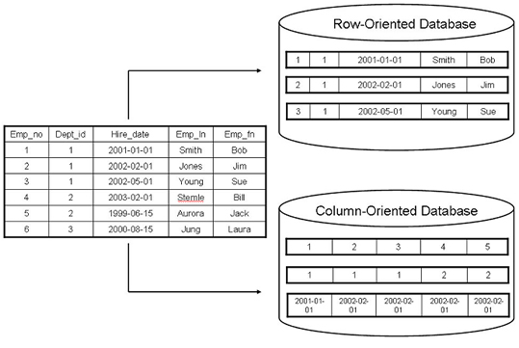
What is ORC Storage Format?

Slide 98
What is ORC Storage Format?
ORC format is useful if your query only requires values from a subset of columns
In row format you still need to read data one record (all columns)
In column format you can read a column in a sequential operation
It is optimized for large streaming reads, but with indexes for finding required rows quickly
Organizing data into columns also offers opportunities for compression
Imagine a column having two value “M” and “F”
This could be compressed using a bit map with 0 for “M” and 1 for “F”
Here eight columns of data could then be packed into one byte making reading that column require much less I/O

Slide 99
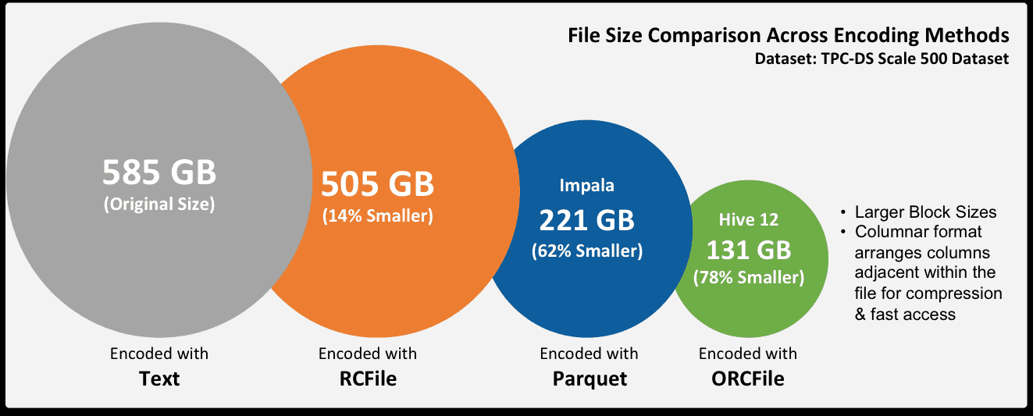
What is ORC Storage Format?

Slide 100
What is the Text File Encoding of Data Values?
You are familiar with text files delimited by commas, the so-called comma-separated values (CSVs)
Or text files delimited by tabs, the so-called tab-separated values (TSVs)
However, there is a drawback to both formats…
You have to be careful about commas or tabs embedded in text and not intended as field or column delimiters
For this reason, Hive uses various control characters by default, which are less likely to appear in value strings

Slide 101
What is the Text File Encoding of Data Values?
Delimiter | Description
\n | For text files, each line is a record, so the line feed character separates records
^A (control-A) | Separates all fields (columns). Written using the octal code \001 when explicitly specified in CREATE TABLE statements
^B | Separate the elements in an ARRAY or STRUCT, or the key-value pairs in a MAP. Written using the octal code \002 when explicitly specified in CREATE TABLE statements
^C | Separate the key from the corresponding value in MAP key-value pairs. Written using the octal code \003 when explicitly specified in CREATE TABLE statements

Slide 102
What is the Text File Encoding of Data Values?
Here is a table declaration with all the format defaults explicitly specified:
CREATE TABLE employees (
name STRING,
salary FLOAT,
subordinates ARRAY<STRING>,
deductions MAP<STRING, FLOAT>,
address STRUCT<street:STRING, city:STRING, state:STRING, zip:INT>
)
ROW FORMAT DELIMITED
FIELDS TERMINATED BY '\001'
COLLECTION ITEMS TERMINATED BY '\002'
MAP KEYS TERMINATED BY '\003'
LINES TERMINATED BY '\n'
STORED AS TEXTFILE;

Slide 103
What is the Text File Encoding of Data Values?
Here is the format of one record we might find in the declared table
John Doe^A100000.0^AMary Smith^BTodd Jones^AFederal Taxes^C.2^Bstate Taxes^C.05^BInsurance^C.1^A1 Michigan Ave.^BChicago^BIL^B60600

Slide 104
What is the Text File Encoding of Data Values?
Here is a table definition where the data will contain the more common comma-delimited fields
Note that we do not indicate the data is stored in TEXTFILE format as this is the default
CREATE TABLE some_data (
first FLOAT,
second FLOAT,
third FLOAT
)
ROW FORMAT DELIMITED
FIELDS TERMINATED BY ',';
Use '\t' for tab-delimited fields.

Slide 105
What are Hive Data Partitions?
Lets assume we have a file of the following format
Based on experience we know that the majority of our queries of this data will have the following form
SELECT ID, Name, Dept FROM table WHERE Year = ‘someYear’
ID | Name | Dept | Year
1 | Joe | IT | 2012
2 | Jane | ECON | 2012
3 | Jill | FIN | 2011
4 | Jack | HR | 2011
5 | Sam | IT | 2010

Slide 106
What are Hive Data Partitions?
Now consider if the table were Terabytes long; we would still need to scan records for years of no interest
But what if could organize our table into tables based on the value of the Year column; call these table partitions
Then each data based query would need to scan many few records and therefore execute more quickly
ID | Name | Dept | Year
1 | Joe | IT | 2012
2 | Jane | ECON | 2012
ID | Name | Dept | Year
3 | Jill | FIN | 2011
4 | Jack | HR | 2011
ID | Name | Dept | Year
5 | Sam | IT | 2010

Slide 107
What are Hive Data Partitions?
Recall these partition tables could still each be very large
Is there a way to reduce the size of data we need to store for each partition?
Recall that each partition holds records for some specific year… each value in the Year column is the same
So a simple optimization is to name each partition something like: Year=2012 or Year=2011
Hive will look at the name of each partition (kept as a subdirectory name) and use that in place of the repeated year value
Year=2012
Year=2011
X
X
ID | Name | Dept | Year
3 | Jill | FIN | 2011
4 | Jack | HR | 2011
ID | Name | Dept | Year
1 | Joe | IT | 2012
2 | Jane | ECON | 2012
Year=2010
X
ID | Name | Dept | Year
5 | Sam | IT | 2010

Slide 108
Some Intuition About Hive Partitions
Let’s imagine that we work for a very large corporation…
Our HR people often run queries with WHERE clauses that restrict the results to a state or city
For example to query the names of employees in the state of Illinois
SELECT name from Employee
WHERE state = “Illinois”
Or for example to query the names of employees in the state of Illinois in the city of Skokie
SELECT name from Employee
WHERE state = “Illinois” and city = ”Skokie”

Slide 109
Some Intuition About Hive Partitions
If the Employee table is contained in one HDFS file or S3 object, Hive will have to scan and records for employees in other states than Illinois and/or other cities than Skokie
As a result, imagining the table has hundreds of millions of records, is that queries are slower than necessary
Why slower than necessary… because Hive mostly scans and skips records of no importance to users
So the amount of I/O operations between the data and storage nodes is unnecessarily high
And, some amount of compute activity, even occurring in parallel, is also wasted on comparing irrelevant records

Slide 110
What are Hive Data Partitions?
Up to this point a table is stored in a file with the table’s name the database directory for that table
So if we have table T1 in database D1 we would see the directory
/user/hive/warehouse/D1/T1
In Hive partitioning, a each partition of a table is stored in a subdirectory where the parent directory has the Table’s name
Each partition subdirectory is named corresponding to a particular value of partition column(s)
When the table is queried, where possible, only required partitions of the table are searched reducing I/O and the time required by the query

Slide 111
Some Intuition About Hive Partitions
An sensible optimization would be to divide the Employee table into multiple tables, one per state, or even one table per city within a state
Employee-Illinois
Employee-Maine
Employee-Illinois-Chicago
Employee-Illinois-Skokie
Let’s call these new tables partitions, because that divide the original table into didtinct and separate parts
Then, if we were interested in the names of employees from Illinois we could issue a query like this
SELECT name FROM Employee-Illinois
SELECT name FROM Employee-Illinois-Skokie

Slide 112
Some Intuition About Hive Partitions
But this leads to one major problem… The query system is not aware of this more efficient grouping
We need to use a different table name depending on our query…
SELECT name from Employee-Illinois
SELECT name from Employee-Maine
Instead of the more general
SELECT name from Employee
WHERE state = <someStateName>
That is, our query system is not partition aware and can’t translate
SELECT name from Employee WHERE state = “Illinois”
Into SELECT name from Employee-Illinois
So our queries are less general, but they are certainly more efficient

Slide 113
What are Hive Data Partitions?
As an example consider the following table definition
CREATE TABLE employees (
name STRING,
salary FLOAT,
city STRING,
state STRING
)
Assume that the file holding data for this table is held in the HDFS directory
/user/hive/warehouse/some-database-name/employees

Slide 114
What are Hive Data Partitions?
Now consider the following table definition where we partition on country and then state
CREATE TABLE employees (
name STRING,
salary FLOAT,
)
PARTITIONED BY (country STRING, state STRING);
You can see the country and state columns are no longer included in the CREATE TABLE definition…
But are included in the partition definition
Note, we do not mention partition attributes twice.
IF these attributes are arguments of the PARTITION BY keyword then the don’t appear again in the schema definition

Slide 115
What are Hive Data Partitions?
Partitioning tables changes how Hive structures the data storage.
If we create this table in the mydb database, there will still be an employees directory for the table
/user/hive/warehouse/mydb.db/employees
But Hive will now create subdirectories reflecting the partitioning structure. For example:
/user/hive/warehouse/mydb.db/employees/country=CA/state=AB
/user/hive/warehouse/mydb.db/employees/country=CA/state=BC
/user/hive/warehouse/mydb.db/employees/country=US/state=AL
The state directories will contain zero or more files for the employees in those states
Once created the partition keys (country and state) behave like actual columns
Because the country and state values are encoded in directory names there is no reason to have this data in the data files themselves
Since these partition fields are only mentioned in the directory path, and not in the HDFS files themselves, we call then virtual fields

Slide 116
What are Hive Data Partitions?
For example, the following query selects all employees in the state of Illinois in the United States:
SELECT * FROM employees WHERE country = 'US' AND state = 'IL’;

Slide 117
What are Hive Data Partitions?
Perhaps the most important reason to partition data is for faster queries.
In the example query, which limits the results to employees in Illinois, it is only necessary to scan the contents of one directory
Even if we have thousands of country and state directories, all but one can be ignored
For very large data sets, partitioning can dramatically improve query performance
But only if the partitioning scheme reflects common range filtering (e.g., by locations, timestamp ranges).
When we add predicates to WHERE clauses that filter on partition values, these predicates are called partition filter
Of course, if you need to do a query for all employees around the globe, you can still do it.
Hive will have to read every directory, but hopefully these broader disk scans will be relatively rare.

Slide 118
What are Hive Data Partitions?
You can see the partitions that exist with the SHOW PARTITIONS command:
hive> SHOW PARTITIONS employees;
country=CA/state=AB
country=CA/state=BC
country=US/state=AL
country=US/state=AK
...

Slide 119
What are Hive Data Partitions?
You can use partitioning with external tables
In fact, you may find that this is your most common scenario for managing large production data sets
The combination gives you a way to “share” data with other tools, while still optimizing query performance
You also have more flexibility in the directory structure used, as you define it yourself
We’ll see a particularly useful example in a moment.

Slide 120
What are Hive Data Partitions?
Here’s how we might define an external partitioned Hive table:
CREATE EXTERNAL TABLE IF NOT EXISTS log_messages (
hms INT,
severity STRING,
server STRING,
process_id INT,
message STRING)
PARTITIONED BY (year INT, month INT, day INT)
ROW FORMAT DELIMITED FIELDS TERMINATED BY '\t';
We assume a day’s worth of log data is the correct size for a useful partition
And finer grain queries over a day’s data will be fast enough

Slide 121
What are Hive Data Partitions?
Recall that when we created the non-partitioned external table, a LOCATION … clause was required
It isn’t used for external partitioned tables
Instead, an ALTER TABLE statement is used to add each partition separately
It must specify a value for each partition key, the year, month, and day, in this case
Here is an example, where we add a partition for January 2nd, 2012:
ALTER TABLE log_messages ADD PARTITION(year = 2012, month = 1, day = 2) LOCATION '/data/log_messages/2012/01/02';
Notice the partition directory naming conventions are up to us

Slide 122
What are Hive Data Partitions?
If used incorrectly, partitioning can lead to performance degradation
The key thing with Hive partitioning is not to over partition
Partitions increase the overhead in data loading and data retrieval
If you create a very large number of partitions with small chunk of data in each partition, you are more likely to have small files
Large number of small files is generally much slower in Hadoop than fewer, larger files
Some of the best practices to consider when partitioning tables
Pick a column for partition key with low to medium Number of Distinct Values (NDVs)
Avoid partitions that are less than 1 GB (bigger is better)
You should avoid deep nesting as it can cause too many partitions and hence create very small files
When you use multiple columns for partition key, it will create a nested tree of subdirectories for each combination of partition key columns

Slide 123
DML Modifying Data in Hive Tables
LOAD
Append data into a Hive table from a (HDFS, local) file or S3 object
INSERT … SELECT
Append data into a Hive table from a SELECT operation
INSERT...VALUES (only transactional/ACID tables)
Used to insert data into Hive tables directly from SQL
UPDATE (only transactional/ACID tables)
Used to update existing data in Hive tables directly from HQL
DELETE (only transactional/ACID tables)
Used to delete existing data from Hive tables directly in HQL

Slide 124
DML LOAD …
Load data into a table from a Linux or HDFS file or S3 bucket into a Hive table
Syntax
LOAD DATA [LOCAL] INPATH 'filepath' [OVERWRITE] INTO TABLE tablename [PARTITION (partcol1=val1, partcol2=val2 ...)]
filepath – Supports absolute and relative paths. If you use optional clause LOCAL the specified filepath would be referred from the server where hive beeline is running otherwise it would use the HDFS path
LOCAL – Use LOCAL if you have a file in the server where beeline is running
OVERWRITE – It deletes the existing contents of the table and replaces with the new content
PARTITION – Loads data into specified Hive table partition

Slide 125
How Do We Load Data Into Hive Tables?
The LOAD command has the following general syntax
LOAD DATA [LOCAL] INPATH 'filepath'
[OVERWRITE] INTO TABLE tablename
[PARTITION (partcol1=val1, partcol2=val2 ...)];
The target being loaded to can be a table or a partition
If the table is partitioned, then one must indicate a specific partition of the table
By specifying values for all of the partitioning column
If the OVERWRITE keyword is used then the contents of the target table (or partition) will be deleted and replaced by the files referred to by filepath
Otherwise the files referred by filepath will be added to the table

Slide 126
How Do We Load Data Into Hive Tables?
If the keyword LOCAL is specified, then:
A local (Linux, Windows, MacOS) file is copied to the table or partition
If the keyword LOCAL is not specified
An HDFS or S3 file is moved to the table or partition

Slide 127
How Do We Load Data Into Hive Tables?
Here is an example of loading a file from the local file system into a specific partition of a Hive database table
LOAD DATA LOCAL INPATH '$home/jrosen/california-employees'
OVERWRITE INTO TABLE employees
PARTITION (country = 'US', state = 'CA');
This command will first create the directory for the partition if it doesn’t already exist…
And then it will copy the data to it; the source file will not be moved as we use the LOCAL option
If the target table is not partitioned, then you omit the PARTITION clause
Hive does not verify that the data you are loading matches the schema for the table
However, it will verify that the file format matches the table definition
For example, if the table was created with SEQUENCEFILE storage, the loaded files must be sequence files.

Slide 128
How Do We Load Data Into Hive Tables?
Notice that on limitation of the LOAD command is the source file is required to be of the same format as the target Hive table
This raises a several questions
How can I load data into a table not in TEXTFILE format, say in ORC format
How can I load data from one Hive table to another
How can I load data into a partitioned table without needing to identify each partition manually
How can I load data from a non-partitioned file or table to a partitioned table
The non-partitioned data source includes partition columns but the partition table must not include them

Slide 129
How Do We Load Data Into Hive Tables?
The INSERT statement lets you load data into a table from a query
INSERT OVERWRITE TABLE employees
PARTITION (country = 'US', state = 'OR')
SELECT * FROM staged_employees se
WHERE se.cnty = 'US' AND se.st = 'OR';
With OVERWRITE, any previous contents of the partition (or whole table if not partitioned) are replaced
If you drop the keyword OVERWRITE or replace it with INTO, Hive appends the data

Slide 130
This example suggests one common scenario where this feature is useful…
Data has been staged in a directory, exposed to Hive as an external table, and now you want to put it into the final, partitioned table
A workflow like this is also useful if you want the target table to have a different record format than the source table (e.g., a different field delimiter)
It is also the primary way data can be moved from a table or file having one storage format to one having a different storage format

Slide 131
How Do We Load Data Into Hive Tables?
Hive supports two partitioning models: static and dynamic
When either is used, queries are run against only a portion of the data, providing significant performance gains.
But what type of partitioning should you use, and when?
Static Partitioning—Used when the values for partition columns are known well in advance of loading the data into a Hive table
Dynamic Partitioning—Used when the values for partition columns are known only during loading of the data into a Hive table

Slide 132
DML INSERT … SELECT
INSERT OVERWRITE will overwrite any existing data in the table or partition
NSERT INTO will append to the table or partition, keeping the existing data intact
Syntax
INSERT OVERWRITE TABLE tablename1
[PARTITION (partcol1=val1, partcol2=val2 ...)
[IF NOT EXISTS]] select_statement1 FROM from_statement;
INSERT INTO TABLE tablename1
[PARTITION (partcol1=val1, partcol2=val2 ...)]
select_statement1 FROM from_statement;

Slide 133
How Do We Load Data Into Hive Tables?
For example, let’s say you have a huge dataset accumulated over many years
You might be concerned about query performance against the Hive table created for this dataset
You could use one or more columns to partition the table created for this underlying data
One possibility would be to partition the data by year
If you already know that the data is nicely segregated by year before it’s loaded into Hive, static partitioning can be used

Slide 134
How Do We Load Data Into Hive Tables?
However, what if the year values are not known in advance of loading the data, and you want to avoid digging into the data to extract year values
In this case, dynamic partitioning is the best approach.
The values of dynamic partition columns are known only at execution time of the data-load query
Hive automatically takes care of not only creating the partitions, but also loading the data into the correct partitions
No manual user intervention is required.
Partition columns are specified by a “PARTITIONED BY” clause in “CREATE TABLE” query
For each distinct set of partition column values, Hive creates a unique HDFS path and loads data into it

Slide 135
How Do We Load Data Into Hive Tables?
To enable dynamic partitioning you must set some Hive properties to non-default value
SET hive.exec.dynamic.partition=true;
SET hive.exec.dynamic.partition.mode=non-strict;

Slide 136
How Do We Load Data Into Hive Tables?
Now let’s assume we have a table defined as follows:
Create the table with partitions:
CREATE TABLE patents (
citing_patent INT,
cited_patent INT,
assignee STRING,
companyname STRING,
publication_date STRING)
PARTITIONED BY (
year INT,
month INT,
day INT);

Slide 137
How Do We Load Data Into Hive Tables?
To load the data into the “patents” table (and overwrite existing records) we specify an INSERT command as follows for some external table
INSERT OVERWRITE TABLE patents
PARTITION (year, month, day)
SELECT citing, cited, name, company, year, month, day
FROM patents_raw_data;
You could append to the table as follows
INSERT INTO TABLE patents
PARTITION (year, month, day)
SELECT citing, cited, name, company, year, month, day
FROM patents_raw_data;
Note, this SELECT must (1) include the partition key columns, (2) these columns must be in the same order as they are listed in the PARTITION and (3) these columns must be listed last

Slide 138
How Do We Load Data Into Hive Tables?
The table, “patents_raw_data”, is an external table, which points to patent raw data
The order of the partition columns specified in the “SELECT” clause is in exactly the same order as the partition columns specified in the “PARTITIONED BY” clause in create table query
Also, the columns year, month, and day are purposefully specified at the very end in the “SELECT” clause
The is required for dynamic partitioning to work
Hive splits the data into multiple partitions by year, month, and day values
It also updates the Hive metastore automatically without explicit user intervention.

Slide 139
How Query Data From Hive Tables?
The SELECT operator outlined here supports queries of Hive databases
SELECT [ALL | DISTINCT] select_expr, select_expr, ...
FROM table_reference
[WHERE where_condition]
[GROUP BY col_list]
[ORDER BY col_list]
[CLUSTER BY col_list
| [DISTRIBUTE BY col_list] [SORT BY col_list]
]
[LIMIT number]
It has many aspects that are similar to the equivalent operator defined in the SQL-92 standard for relational databases
This facilitates its use by analysts who are familiar with that paradigm

Slide 140
How Query Data From Hive Tables?
Examples
SELECT * FROM sales WHERE amount > 10 AND region = "US”
The following query returns 5 arbitrary customers
SELECT * FROM customers LIMIT 5

Slide 141
How Query Data From Hive Tables?
In general, a SELECT query scans the entire table
If a table created using the PARTITIONED BY clause, a query can do partition pruning and scan only a fraction of the table related to partitions specified by the query
Hive currently does partition pruning if the partition predicates are specified in the WHERE clause
Or the ON clause in a JOIN

Slide 142
How Query Data From Hive Tables?
If table page_views is partitioned on column date…
The following retrieves rows for just days between 2008-03-01 and 2008-03-31
SELECT page_views.*
FROM page_views
WHERE page_views.date >= '2008-03-01'
AND page_views.date <= '2008-03-31'

Slide 143
How Query Data From Hive Tables?
When you select columns that are one of the collection types, Hive uses JSON (JavaScript Object Notation) syntax for the output
First, let’s select an ARRAY, where a comma-separated list surrounded with […] is used
Note that STRING elements of the collection are quoted

Slide 144
Computing With Column Values
Not only can you SELECT columns in a table…
But you can manipulate column values using function calls and arithmetic expressions
SELECT upper(name), salary, deductions["Federal Taxes"],
round(salary * (1 - deductions["Federal Taxes"])) FROM employees;

Slide 145
How Query Data From Hive Tables?
A special kind of function is the aggregate function that returns a single value resulting from some computation over many rows
Perhaps the two best known examples are count, which counts the number of rows and avg, which returns the average value of the specified column values
Here is a query that counts the number of employees, averages their salaries and provides the min and max salaries
SELECT count(*), avg(salary), min(salary), max(salary)
FROM employees;

Slide 146
How Query Data From Hive Tables?
While SELECT clauses select columns, WHERE clauses are filters; they select which records to return
SELECT * FROM employees
WHERE country = 'US' AND state = 'CA';
SELECT e.* FROM
(SELECT name, salary, deductions["Fed Taxes"] as ded,
salary * (1 - deductions["Fed Taxes"]) as salary_minus_fed_taxes
FROM employees) e
WHERE round(e.salary_minus_fed_taxes) > 70000;

Slide 147
How Query Data From Hive Tables?
Hive supports the classic SQL JOIN statement, but only equi-joins are permitted
INNER JOIN
OUTER JOIN
LEFT OUTER JOIN
RIGHT OUTER JOIN
SELECT a.ymd, a.price_close, b.price_close
FROM stocks a JOIN stocks b ON a.ymd = b.ymd
WHERE a.symbol = 'AAPL' AND b.symbol = 'IBM';
Only equi-join allowed

Slide 148
Row Level ACID Transactions in Hive
Imagine that you want to update a row (record) in an HDFS file using Hive
Lets refer to the updating of a single row as a “row level transaction”
What is one significant problem that might occur during a row level transaction…
Assume the row is in process of being updated by a writer (but not completely updated)
Let a reader come along and before the row is completely updated with new values, read the row
So the reader is given a row the is inconsistent, and has some original and some new values
So what properties should a transaction have to prevent inconsistent reads?
These are Atomicity, Consistency, Isolation, and Durability or ACID properties…
Atomicity means, a transaction should complete successfully or else it should fail completely i.e. it should not be left partially
Consistency ensures that any transaction will bring the database from one valid state to another state
Isolation states that every transaction should be independent of each other i.e. one transaction should not affect another
Durability states that if a transaction is completed, it should be preserved in the database even if the machine state is lost or a system failure might occur

Slide 149
ACID Transaction Scope and Limits
The different row-level transactions available in Hive are as follows:
Insert
Delete
Update
There are numerous limitations with the present transactions available in Hive
Only ORC file format is supported
Tables need to be bucketed in order to support transactions
External tables cannot be made ACID tables

Slide 150
How Do We Insert Data into a Hive Table
The INSERT...VALUES statement can be used to insert data into tables directly
INSERT INTO TABLE tablename [PARTITION (partcol1[=val1], partcol2[=val2] ...)] VALUES values_row [, values_row ...]
Where values_row is:
( value [, value ...] )
where a value is either null or any valid SQL literal
Values must be provided for every column in the table. The standard SQL syntax that allows the user to insert values into only some columns is not yet supported
To mimic the standard SQL, nulls can be provided for columns the user does not wish to assign a value to
Dynamic partitioning is supported
If the table being inserted into supports ACID and a transaction manager that supports ACID is in use, this operation will be auto-committed upon successful completion

Slide 151
How Do We Insert Data into a Hive Table
CREATE TABLE students (name VARCHAR(64), age INT, gpa DECIMAL(3, 2))
CLUSTERED BY (age) INTO 2 BUCKETS STORED AS ORC;
INSERT INTO TABLE students
VALUES ('fred flintstone', 35, 1.28), ('barney rubble', 32, 2.32);
---
CREATE TABLE pageviews (userid VARCHAR(64), link STRING, came_from STRING)
PARTITIONED BY (datestamp STRING)
CLUSTERED BY (userid) INTO 256 BUCKETS
STORED AS ORC;
INSERT INTO TABLE pageviews PARTITION (datestamp = '2014-09-23')
VALUES ('jsmith', 'mail.com', 'sports.com'), ('jdoe', 'mail.com', null);
INSERT INTO TABLE pageviews PARTITION (datestamp)
VALUES ('tjohnson', 'sports.com', 'finance.com', '2014-09-23'), ('tlee', 'finance.com', null, '2014-09-21');

Slide 152
How Do We Update Data into a Hive Table
UPDATE tablename SET column = value [, column = value ...] [WHERE expression]
Updates can only be performed on tables that support ACID
The referenced column must be a column of the table being updated
Only rows that match the WHERE clause will be updated
Partitioning columns cannot be updated
Bucketing columns cannot be updated

Slide 153
How Do We Update Data into a Hive Table
CREATE TABLE hello_acid (key int, value int) PARTITIONED BY (load_date date)
CLUSTERED BY(key) INTO 3 BUCKETS
STORED AS ORC
TBLPROPERTIES ('transactional'='true’);
INSERT INTO hello_acid partition (load_date='2016-03-03') VALUES (3, 3);
UPDATE hello_acid SET value = 10 WHERE key = 3;

